Slide 1


Slide 2

<WELCOME >
<Matrices>

Slide 3
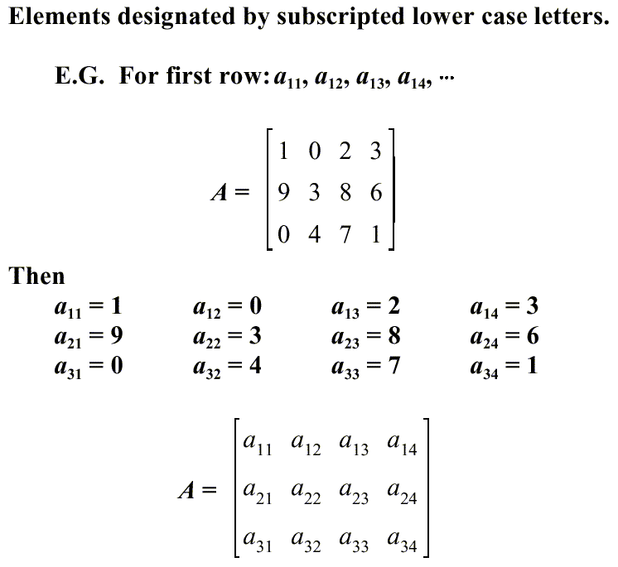

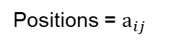
Matrices Fundamentals
Positions = $a_{ij}$

Slide 4
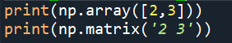
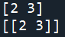
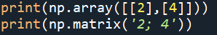
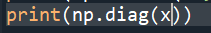
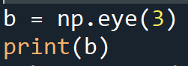
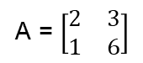
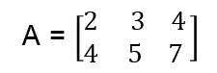
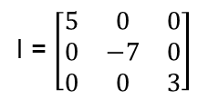
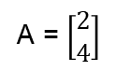
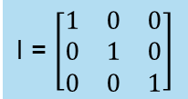
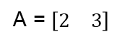
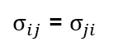
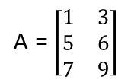
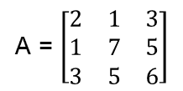
Types :
A = $\left[\begin{matrix}1 & 3 \\ 5 & 6 \\ 7 & 9\end{matrix}\right]$
A = $\left[\begin{matrix}2 \\ 4\end{matrix}\right]$
A = $\left[\begin{matrix}2 & 3 4 \\ 4 & 5 7 \end{matrix}\right]$
A = $\left[\begin{matrix}2 & 3\end{matrix}\right]$
Row matrix
Column matrix
Rectangular matrices
rows m = 1
columns n = 2
rows m = 2
columns n = 1
rows m = 2
columns n = 2
rows m = 3
columns n = 2
Square matrix
Symmetric matrix
Diagonal matrix
Unit matrix
A = $\left[\begin{matrix}2 & 3 \\ 1 & 6\end{matrix}\right]$
A = $\left[\begin{matrix}2 & 1 & 3 \\ 1 & 7 & 5 \\ 3 & 5 & 6\end{matrix}\right]$
I = $\left[\begin{matrix}5 & 0 & 0 \\ 0 & −7 & 0 \\ 0 & 0 & 3\end{matrix}\right]$
I = $\left[\begin{matrix}1 & 0 & 0 \\ 0 & 1 & 0 \\ 0 & 0 & 1\end{matrix}\right]$
rows m = 2 = n
$σ_{ij}$ = $σ_{ji}$

Slide 5
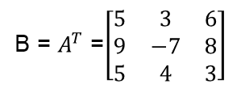
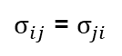
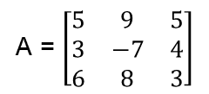
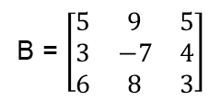
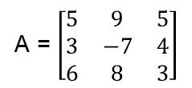
Matrices operations and properties
Equal
A = $\left[\begin{matrix}5 & 9 & 5 \\ 3 & −7 & 4 \\ 6 & 8 & 3\end{matrix}\right]$
B = $\left[\begin{matrix}5 & 9 & 5 \\ 3 & −7 & 4 \\ 6 & 8 & 3\end{matrix}\right]$
A = B
Same elements
Same dimensions
Transpose
$σ_{ij}$ = $σ_{ji}$
A = $\left[\begin{matrix}5 & 9 & 5 \\ 3 & −7 & 4 \\ 6 & 8 & 3\end{matrix}\right]$
B = $A^{T}$ =$\left[\begin{matrix}5 & 3 & 6 \\ 9 & −7 & 8 \\ 5 & 4 & 3\end{matrix}\right]$

Slide 6
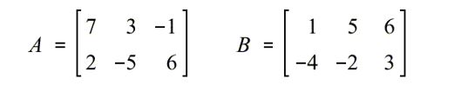
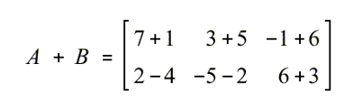
Matrices addition
Commutative properties
A +B = B+A
Associative Properties
A+(B+C) = (A+B) +C

Slide 7
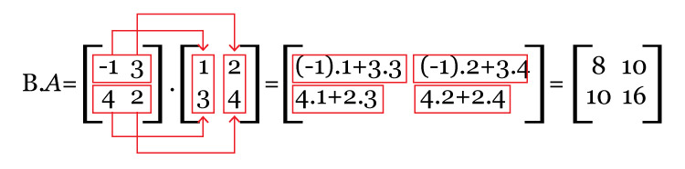
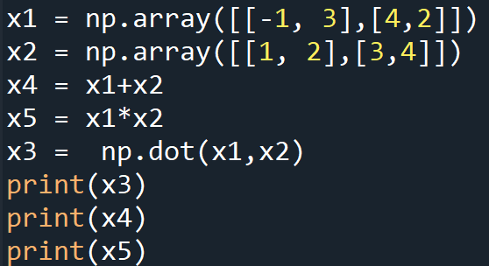
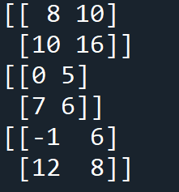
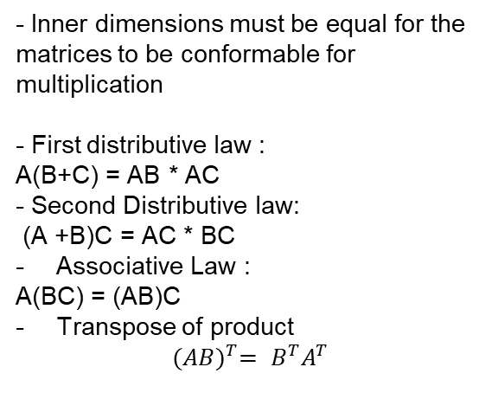
- Inner dimensions must be equal for the matrices to be conformable for multiplication
- First distributive law :
A(B+C) = AB * AC
- Second Distributive law:
(A +B)C = AC * BC
Associative Law :
A(BC) = (AB)C
Transpose of product
$${(AB)}^{T}= B^{T}A^{T}$$
Matrices multiplication
AB ≠ BA
If AB = 0, A and/or B can be ≠ 0
If AB = AC, B can be ≠ C

Slide 8
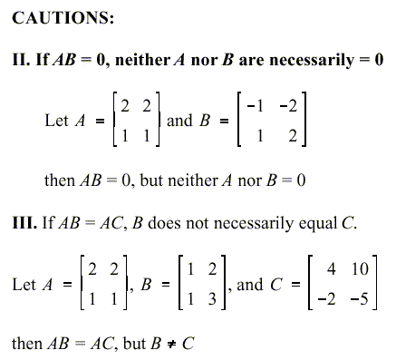

Slide 9
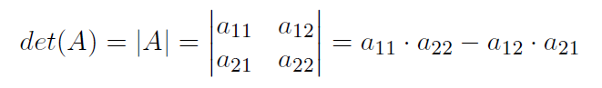
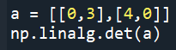
Matrices determinants

Slide 10
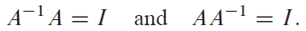
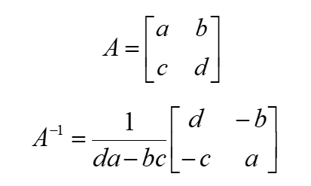
Inverse matrices:
The matrix A is invertible if there exists a matrix A1 such that
Inverse of a 2x2 Matrix

Slide 11
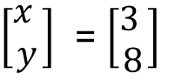



Representing equations using matrices
$$1x+2y =3$$
$$6x−3y =8$$
$\left[\begin{matrix}x \\ y\end{matrix}\right]$ = $\left[\begin{matrix}3 \\ 8\end{matrix}\right]$
$$\left[\begin{matrix}1 & 2 \\ 6 & −3\end{matrix}\right]$$
Coefficients are placed in one matrix
Variables are placed in another matrix
Constants are placed in a third matrix

Slide 12
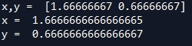
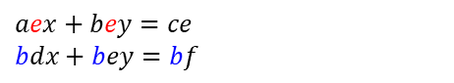

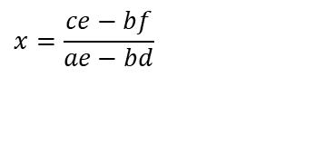

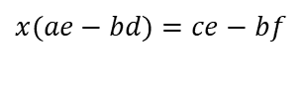
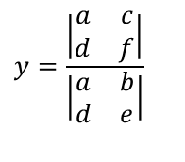
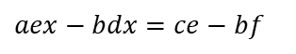
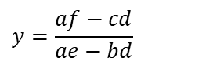
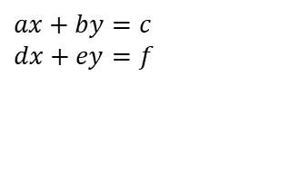
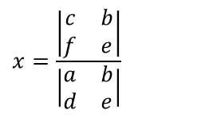
Solving using cramer’s method
$$ax+by=c \\ dx+ey=f$$
Let’s eliminate y
$$aex+bey=ce \\ bdx+bey=bf$$
$$aex−bdx=ce−bf$$
$$x(ae−bd)=ce−bf$$
$$1x+2y =3$$
$$6x−3y =8$$
$$y=\frac{af−cd}{ae−bd}$$
$$x=\frac{ce−bf}{ae−bd}$$
A = np.matrix('1 2;6 -3’)
A1 = np.matrix('3 2;8 -3’)
A2 = np.matrix('1 3;6 8’)
det1 = np.linalg.det(A)
det2 = np.linalg.det(A1)
det3 = np.linalg.det(A2)
print ('x = ', det2/det1)
print('y = ', det3/det1)
Determinants
$$y=\frac{\left|\begin{matrix}a & c \\ d & f\end{matrix}\right|}{\left|\begin{matrix}a & b \\ d & e\end{matrix}\right|}$$
$$x=\frac{\left|\begin{matrix}c & b \\ f & e\end{matrix}\right|}{\left|\begin{matrix}a & b \\ d & e\end{matrix}\right|}$$
Look familiar?

Slide 13
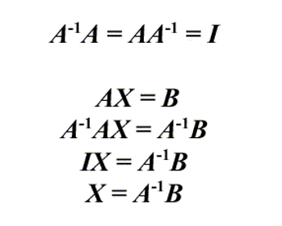
Solving by using matrices inverses
The inverse matrix is the opposite of multiplication:
import numpy as np
A = np.matrix('1 2;6 -3’)
B = np.array([3, 8])
X = np.linalg.inv(A).dot(B)
print('x,y = ‘,X)

Slide 14
Solving using scipy or numpy libraries
$$1x+2y =3$$
$$6x−3y =8$$
Import scipy as la
Import numpy as np
x = np.linalg.solve(M,b)
y = la.linalg.solve(M,b)
$\left[\begin{matrix}x \\ y\end{matrix}\right]$ = $\left[\begin{matrix}3 \\ 8\end{matrix}\right]$
$$\left[\begin{matrix}1 & 2 \\ 6 & −3\end{matrix}\right]$$
numpy.linalg for more linear algebra functions.
Note that although scipy.linalg imports most of them, identically named functions from scipy.linalg
may offer more or slightly differing functionality.

Slide 15
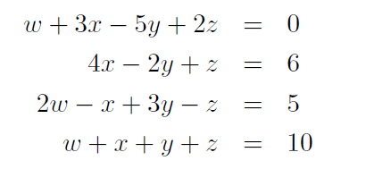
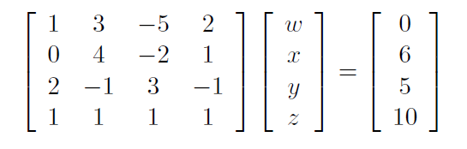

l = []; l1 = []
fig,ax = plt.subplots(3,1)
M = np.array ([[1,3,-5, 2], [0,4,-2,1], [2,-1,3,-1],[1,1,1,1]])
b = np.array ([0,6,5,10])
l.append(b)
x = np.linalg.solve(M,b)
print(x)
l1.append(x)
ax[0].axis('off')
ax[0].imshow(M)
ax[1].axis('off')
ax[1].imshow(l)
ax[2].imshow(l1)
ax[2].axis('off')
https://matplotlib.org/3.3.3/api/_as_gen/matplotlib.pyplot.imshow.html

Slide 16
Other Methods of Matrix Solution
Gaussian elimination
For large matrices with many zeros, sparse matrix methods can be used

Slide 17
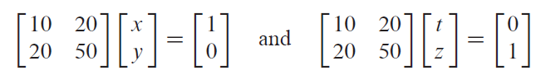
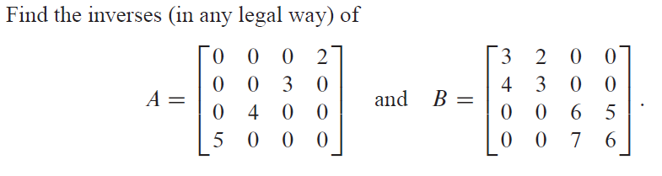
1.
Solve
2.

Slide 18
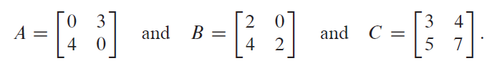
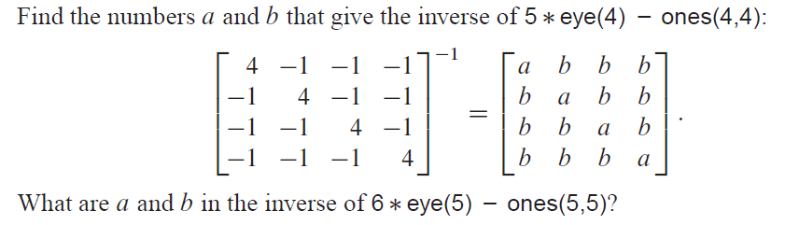
3.
.
4.

Slide 19
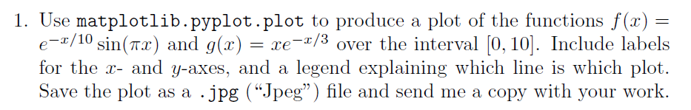

5.
6.
Plot the result using matplotlib

Slide 20


7.
8.
Solve matrix exercise from the 4th list

Slide 21
Make it work
Make it Right
Make it Fast

Slide 22


